Slide 1
POVERTY AND POLLUTION IN TENNESSEE
Robert Parker//da09
Notes:
Hello, everybody. Thanks for taking time out of your evening to join me today, I’ll try not to bum you out too hard.

Slide 2
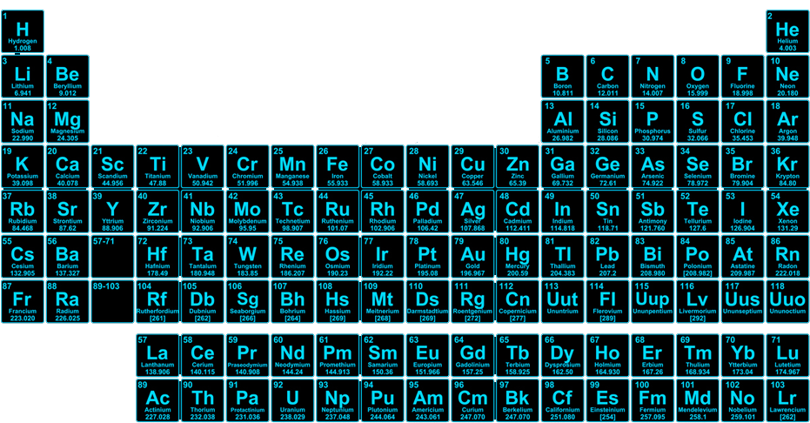
Notes:
So, for most of recorded history, humans have been surrounding themselves with a potent neurotoxin known as…

Slide 3
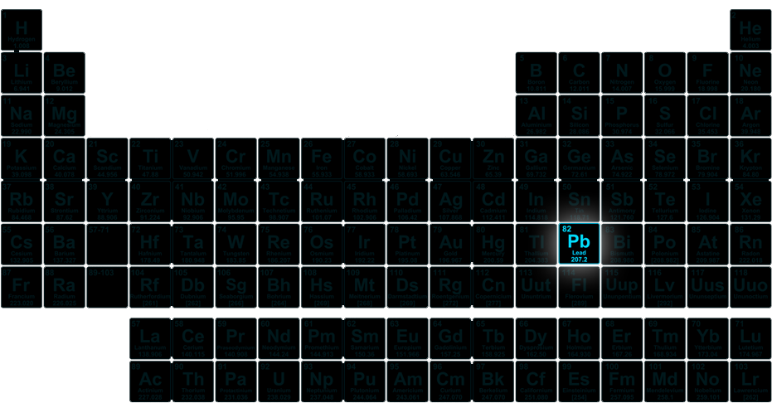
Notes:
Lead! Now, lead has a lot of great properties that made it a hot choice for metal workers and craftspeople for tens of thousands of years. It’s abundant in nature, it’s soft, malleable, very slow to rust, it has a low melting point, but maybe most importantly: it’s easy to extract.

Slide 4

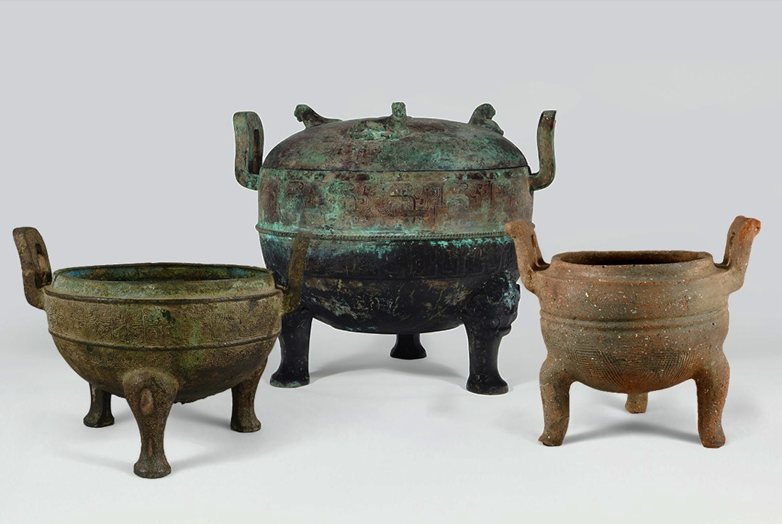
THE HISTORY OF LEAD
Ancient Egypt
Ancient China
The ancient, smokey eye makeup known as “Kohl” is made from lead ores
These ritual cauldrons were made from an alloy containing copper, tin, and lead
Notes:
And we really have been at it for tens of thousands of years. That classic smokey eye look we see in ancient Egyptian art is called “Kohl,” and it was made by grinding up chunks of lead sulfide. Imagine putting that much lead so close to your eye, right? Kohl makeup is still really popular in the middle east, and modern kohl is made from much safer materials, but there wasn’t really a concerted effort to get the lead out until the early 90s.
And here on the right, we have a couple of ritual drinking cauldrons from the Ding dynasty, which was around the 10th and 11th century BC. And these were made from a bronze alloy that was comprised of copper, tin, and lead. That’s another great thing about lead, you can add it to alloys to lower their melting point and make them easier to work with.
But royals would drink this highly acidic wine that would leech incredible amounts of lead, like highly toxic amounts into the rest of the cauldron. There was this one princess-general named Fu Hao that would famously get these visions and hallucinations, and historians nowadays believe that it was just lead poisoning.

Slide 5
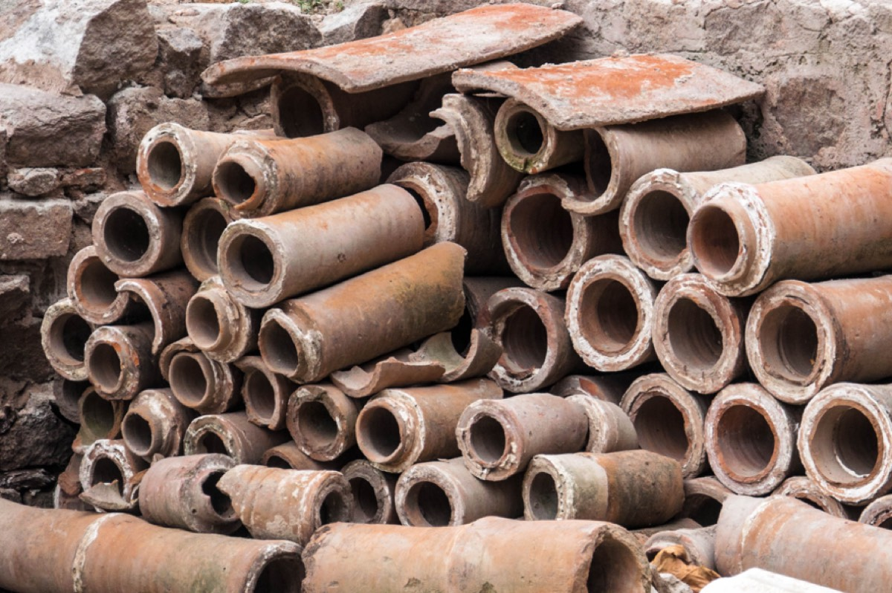
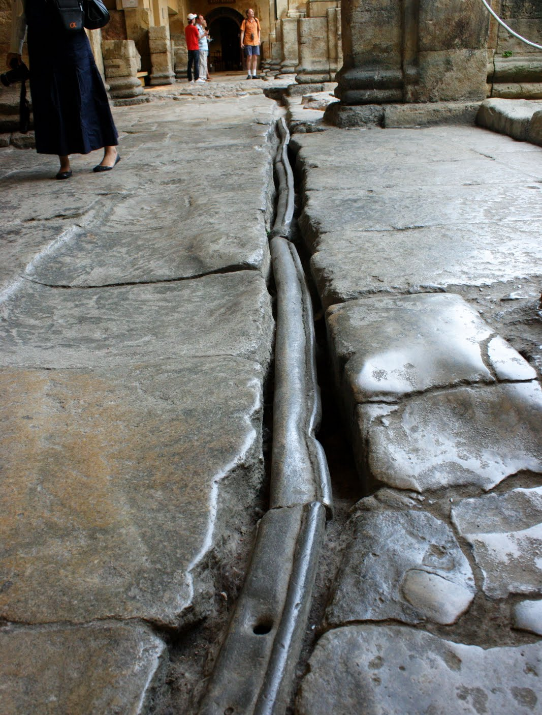
ANCIENT ROME
At its peak, the Roman civilization was producing 60,000 to 80,000 tons of lead per year
Notes:
And of course, we all know about the lead piping used by the ancient Romans. Folks like to say that this contributed to the downfall of the whole empire, and it probably did. But what was worse perhaps is the fact that their eating utensils and drinking vessels were also made from lead.
They also produced a sweetener called Sapa that was made by boiling unfermented grape juice in…lead kettles. So even if decades of unsoftened, unfiltered water may have left some lines with a kind of protective layer of sediment and limescale in their lead pipes, they still have a way to get their daily dose of neurotoxins.

Slide 6
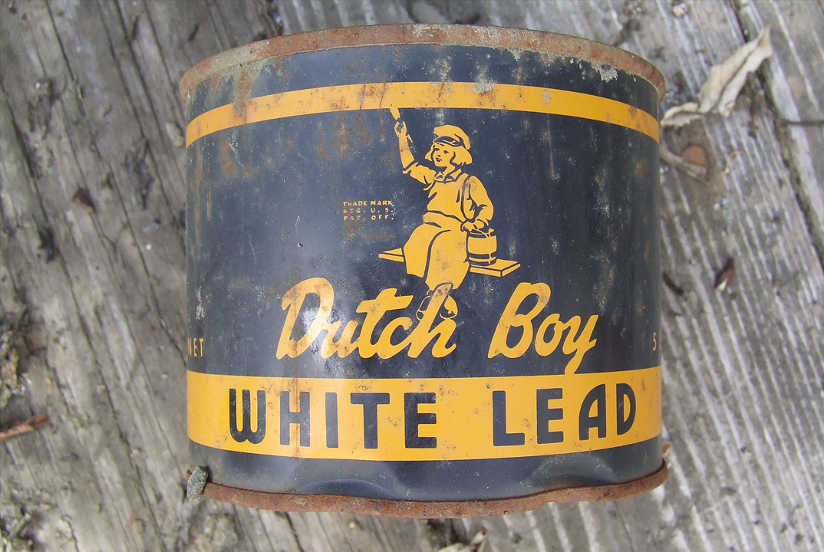
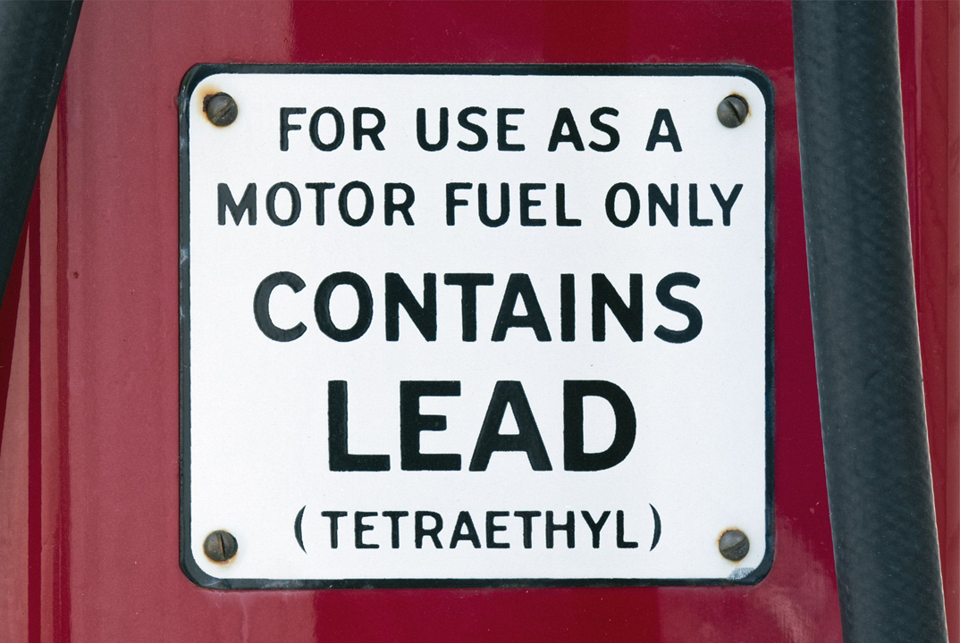

MODERN SOURCES OF LEAD
Lead Paint
Leaded Gasoline
Lead additives accelerate drying and increases durability
Tetraethyllead boosts octane rating and improves performance and fuel economy
Notes:
So we’re all aware of these two most common sources of ambient lead in our immediate environments. Lead has been added to paint since the 4th century BC partially because it helps speed up drying and improves durability, but largely because until the 20th century it was the only truly white pigment available in enough quantities to be actually useful. Nowadays we have zinc white and titanium white, but the next time you’re at an art gallery and you see a painting from the 1800s or earlier, it’s probably full of lead.
Up until it was banned in 1978, lead paint was used extensively in home construction. If anyone here is a homeowner, you know that the sales contracts on these older homes include a disclosure that basically says, “Hey, this house might have lead paint. Hope that’s cool!” And of course everyone signs it. There’s no law requiring that any lead paint be removed or encapsulated, and any work you do on a house that has lead paint has the potential to introduce lead dust into your environment.
So, leaded gasoline is particularly bad. Ever since the 1920s, tetraethyllead was added to gasoline because it greatly improves performance and fuel economy. The problem is that its molecular makeup allows it to dissolve in oils and fats, which lets it easily cross the blood-brain barrier. So imagine millions of vehicles pumping out this aerosolized, extra deadly form of lead all day, every single day. It’s accumulating in trees and soil, people are breathing it in, it’s collecting on the road and getting washed away into lakes and rivers and aquifers. The use of catalytic converters wasn’t required by law until 1975 and the outright sale of leaded gasoline wasn’t banned until 1996. It’s still used to this day in aircraft fuel but for the vast majority of the developed world, it’s been totally phased out.
Now, there are some less well-known modern sources of lead that might surprise you.

Slide 7




MODERN SOURCES OF LEAD
Cosmetics
Candy
99% of externally applied cosmetics contain up to 10ppm of lead
Lead acetate was used as a sweetener, and ink used in candy wrappers can contain lead
Notes:
It’s pretty much phased out by now, but lead was added to cosmetics for centuries because like I mentioned earlier it was the only real source of white pigment. As you can see here there’s still tiny amounts present in, but remember it accumulates in your body, right? And the EPA has been very clear that there is so safe level of lead that isn’t toxic to some extent. That’s a very important point: no amount of lead exposure is safe.
Lead acetate, or lead sugar as it was called back in the day, was pretty common in candy and some spices at the turn of the century. But even today, candy that’s been imported from other parts of the world have the danger of being contaminated with lead during the production process, and to this day small amounts of ink present in the ink used on candy wrappers and soak into the candy within.

Slide 8
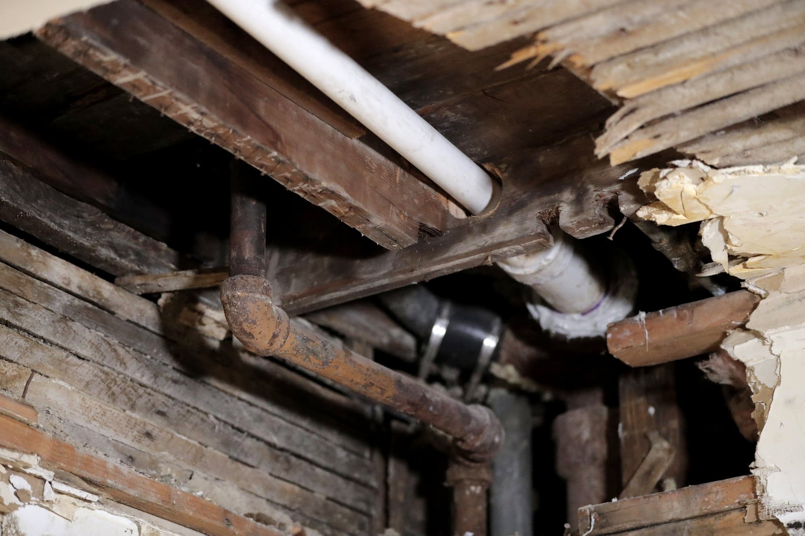
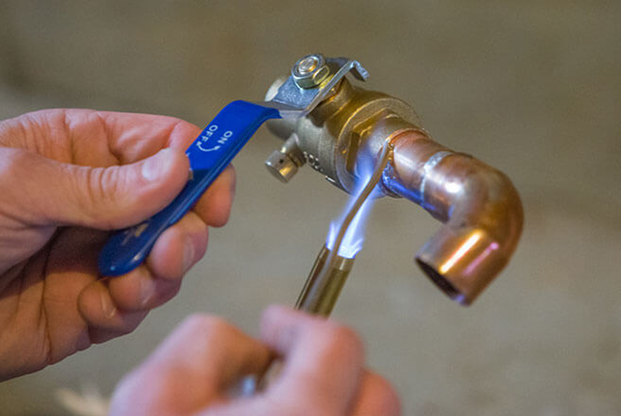


MODERN SOURCES OF LEAD
Lead Pipes
Lead Solder
The EPA estimates that 9.2 million lead water pipes are still in use
Joining copper pipes with lead solder was the industry standard until 1986
Notes:
Now, we’re all aware of the dangers of using lead water pipes. It’s especially bad in residential use because the heat from hot water lines can actually cause more lead to leech into your water. But even if you have copper piping, you’re not totally out of the woods because the use of lead solder to join pipes was the industry standard up until it was banned in 1986. And again, any high temperature water going past those joints has the potential to bring some of that lead along with it.
And if you’re not sure if a particular pipe in your home is galvanized steel or lead, try using a magnet. Lead isn’t magnetic, so if it sticks to the pipe you’re good to go.

Slide 9
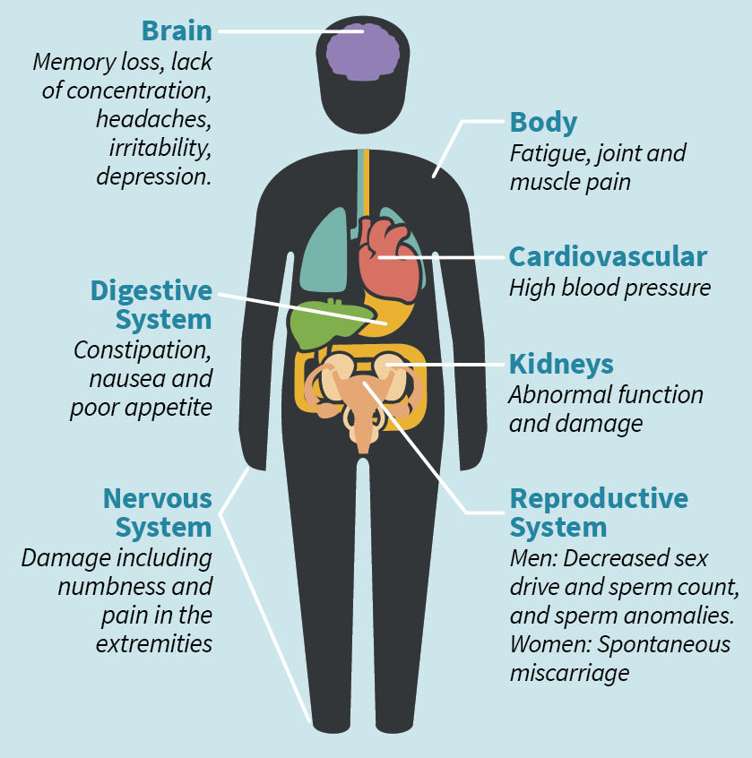
Memory Loss
Lack of Concentration
Irritability
Depression
Notes:
Now, what are the actual effects of lead poisoning? Well, I’ve highlighted some of the mental effects on adults here: memory loss, lack of concentration, irritability, depression, but it wreaks havoc on the entire body. High blood pressure, kidney damage, increased chance of miscarriage…no part of the body is spared. But the effects are worse on children.

Slide 10
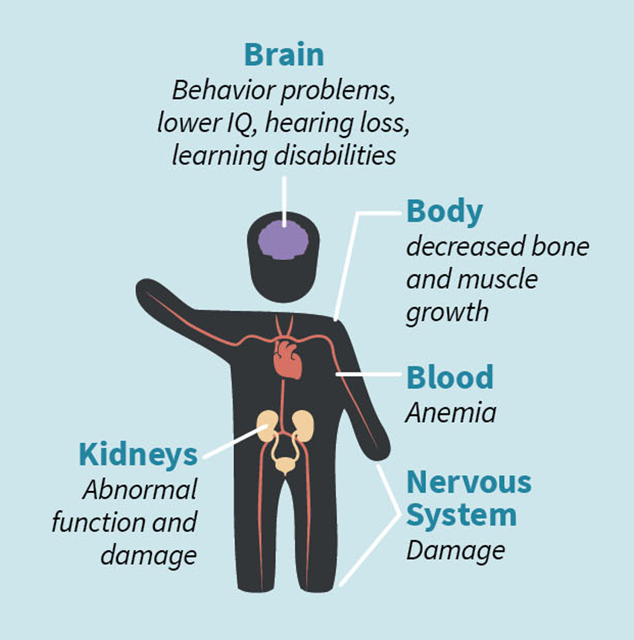
Behavior Problems
Lower IQ
Cognitive Dysfunction
Hearing Loss
Notes:
Most notably on their nervous systems. We’ve observed behavior problems, lower IQ’s, cognitive dysfunction, even hearing loss…and a lot of these symptoms aren’t truly evident until they reach adolescence or adulthood. So by the time a parent can be made aware of the danger, it’s already too late. These kids are damaged permanently.
So it’s critically important that we remove or eliminate lead from as many communities as possible so we’re not starting another generation off with a handicap. And at the federal level we’ve made a lot of progress in the past 50 years. So how are we doing here in Tennessee? Good? Bad? And if we’re doing badly, what’s the human cost? Let’s take a look.

Slide 11
Elevated Blood Lead Levels (EBLL)
Blood lead concentrations above 5_{μg/dL} (micrograms per deciliter) are considered elevated
Notes:
One way we can figure this out is by measuring what’s called EBLL, or Elevated Blood Lead Levels. Every year, the Tennessee Department of Health tests the lead levels in a selection of children in all 95 counties, and when they get a result higher than 5 micrograms of lead per deciliter of blood, it’s logged and reported to the Centers for Disease Control. That’s 5 millionths of a gram per one tenth of a liter, which is about three and half ounces. That’s how little lead it takes to permanently alter a child. And that threshold was actually reduced to 3.5 millionths back in October of last year. The numbers for 2023 and beyond are probably gonna be pretty grim.

Slide 12
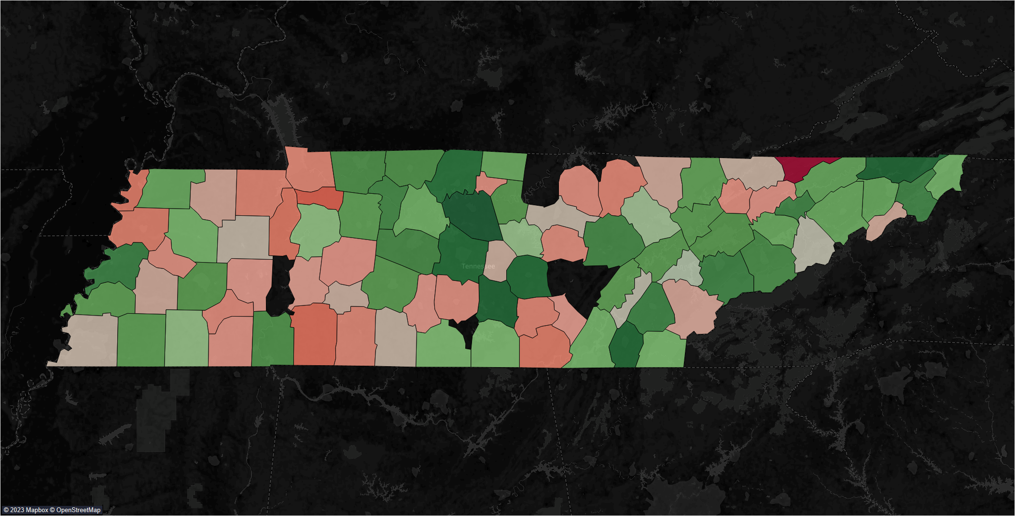
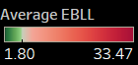
Notes:
So for this map I took the average EBLL per 1,000 children from the past 5 years of publicly available data and then assigned it to the appropriate county. A few counties had their data suppressed because there were fewer than 50 children living there, so at the end of the day we’re looking at 88 out of 95 counties. And color-wise, we’re looking at green being fewer children per capita with an elevated blood lead level and closer to red representing a higher EBLL.
You probably already noticed that one bright red blight up there in the top right corner…that’s Hancock County, and nearly 34 out of every 1,000 children there have an elevated blood lead level. Almost twice the rate of the second worst county, Houston. But we’ll get back to that in a second.

Slide 13
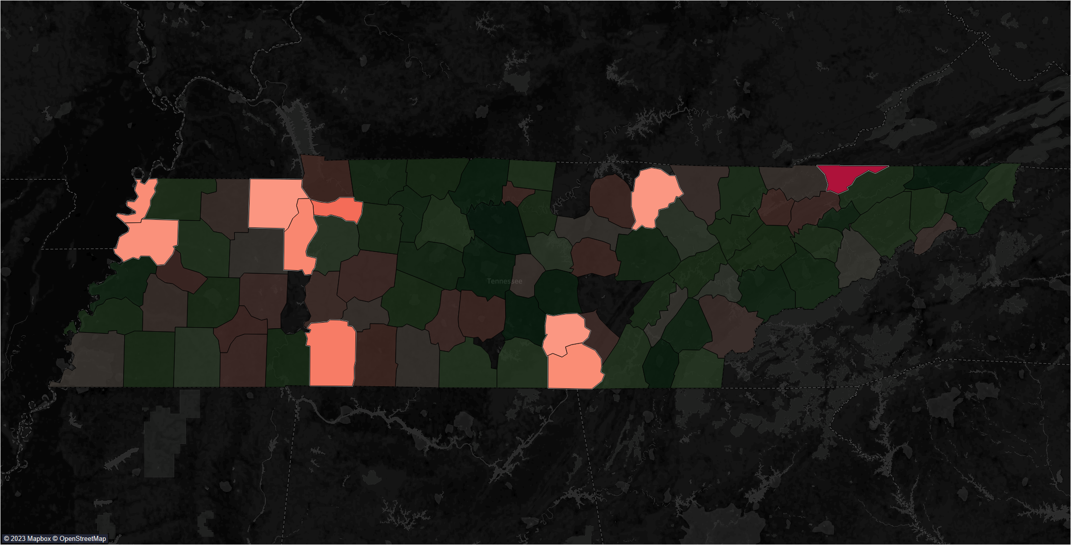
Notes:
So here are the top 10 counties in terms of highest EBLL. We’ve got Hancock, Houston, Wayne, Benton, Marion, Lake, Dyer, Henry, Grundy, and Fentress.

Slide 14
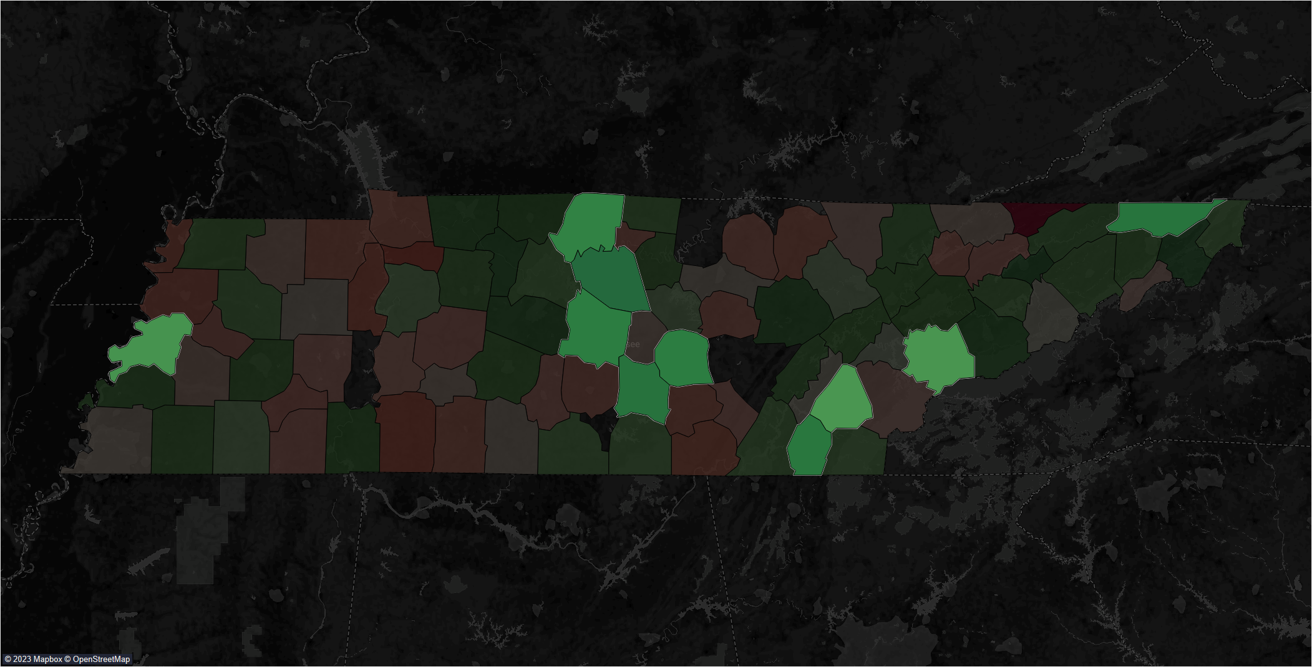
Notes:
And here are the top 10 in terms of lowest EBLL. That’s Wilson, Coffee, Sullivan, Bradley, Rutherford, Warren, Sumner, Lauderdale, Blount, and McMinn.

Slide 15
High EBLL
Low EBLL
Median Income | $22,209 | $28,447
Population | 18,390 | 126,576
Poverty Rate | 19.8% | 13.7%
Notes:
Here’s how both groups compare at a glance. And these numbers are all averages. So as you can see, counties with higher blood lead levels tend to be less populous and have lower incomes. The difference in the poverty rate here is pretty striking. 1 in 5 people in high EBLL counties live below the poverty line, and in Hancock County it’s 1 in 3. Meanwhile, the low EBLL counties are pretty much on par with the average poverty rate and median income for Tennessee as a whole. Now, let’s see how they compare in other ways.

Slide 16
Average EBLL per 1,000 Children
6.9
Notes:
First let’s check out the average EBLL in both groups. Children in the high counties are 6 times more likely to have an elevated lead level than those in the low counties. That’s huge! You would expect that the more dense and urban counties that make up the lower group would be higher, not only because there’d more opportunities to be exposed to lead but because the available testing pool would be higher. [CLICK] But here’s the average for all of Tennessee and it’s way lower. So what are the consequences?

Slide 17
Infant Mortality per 1,000 Births
7.2
Notes:
So here’s an area where Tennessee as a whole is in bad shape. We rank 11th in the nation for highest infant mortality rates. The low counties here are right at the national average, [CLICK] and they’re even below the average for all of Tennessee, which is 7.2. Now, a difference of 2 deaths between the two groups may not seem like much, but to put it into perspective: if that 7.8 rate were true of all of Tennessee, it would amount to about 150 more infant deaths per year.

Slide 18
Disabilities
6.4%
0.6%
Cognition
Hearing
Notes:
So if you’ll recall from earlier, prenatal or childhood exposure to lead has been shown to lead to the development of hearing and cognitive disabilities. And the rate of cognitive disabilities is really striking here. It’s nearly 10% for the high EBLL counties. And this includes a broad spectrum of disorders: ADHD, epilepsy, hydrocephaly, autism, dyslexia, just to name a few.
(CLICK)
Here are the rates for both for all of Tennessee. Hearing loss among children is right on par with the rest of the state, but it’s double the average in the high counties.

Slide 19
Premature Deaths per 100,000
493.4
Notes:
So this is the rate of premature deaths. The CDC defines any death that occurs before the age of 75 as being premature, and these figures are age-adjusted which means that more weight is given to deaths at a younger age than deaths that occur closer to 75. (CLICK) And here’s the rate for all of Tennessee.
It’s pretty striking how much more the rate is in the high county group, but you can’t really blame this one entirely on lead, right? It’s just a fact that the poorer you are, the shorter your life is gonna be. There’s a lot of reasons why this is the case, but the ones that we can actually influence on a policy level are how well these lower income communities are serviced and protected.
So is there a difference in the amount of effort we’ve put into the low and high counties? There’s a couple of metrics we can check to find out.

Slide 20
Housing Dangers
DPI
Pre 1979 Homes
Notes:
DPI here stands for “Deteriorated Paint Index,” which is a figure used by The Department of Housing and Urban Development to predict the percentage of occupied housing units with large areas of deteriorated paint, which is a strong predictor of the presence of lead dust. And if you’ll recall, the use of lead paint was banned in 1978, so any home built before 1979 has a significant chance of containing lead painted surfaces.
And as you can see, roughly half of the homes in both groups were built before 1979. But there isn’t a huge disparity in either value between the two groups. Certainly not one big enough to explain why blood lead levels are 6 times higher in the high county group.
So if each group has roughly the same chance at ambient, everyday exposure to lead but one group is doing significantly worse than the other, you could conclude that the worse-of group is being neglected in some way. But there’s one more thing we can check, and with that it’s finally time to talk about Hancock County.

Slide 21
Notes:
If you’ll recall from earlier, Hancock County had the highest EBLL out of every county in the high group.

Slide 22
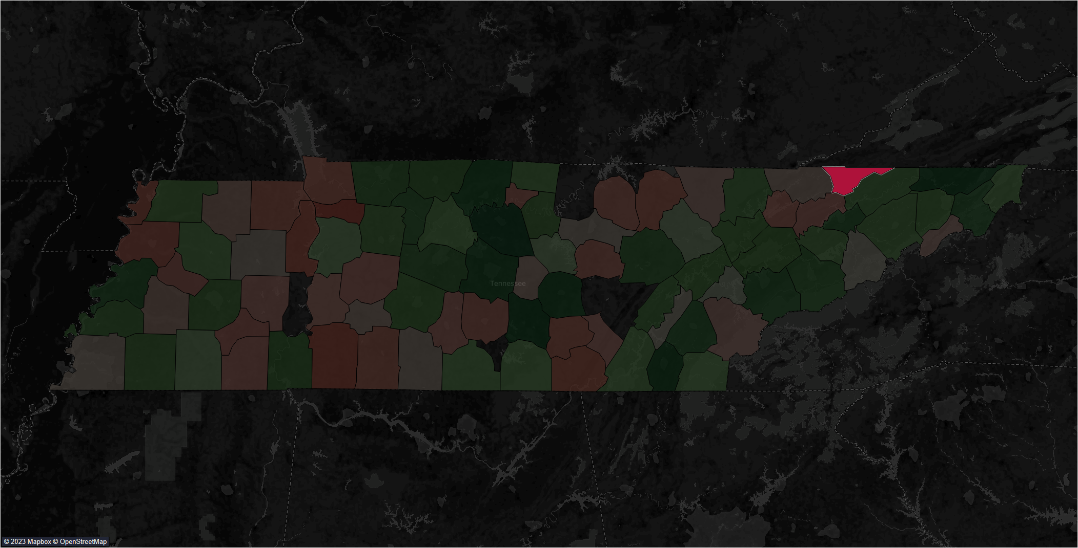
Notes:
It’s almost twice as high as the next county on the roster. Now, in this moment Hancock County has the lowest median income in all of Tennessee. It’s probably our poorest county, but that wasn’t always the case.
Back in the 1950s, it was discovered that Hancock was rich with zinc deposits, and for the next 20 or so years Zinc became Hancock’s principal export.

Slide 23
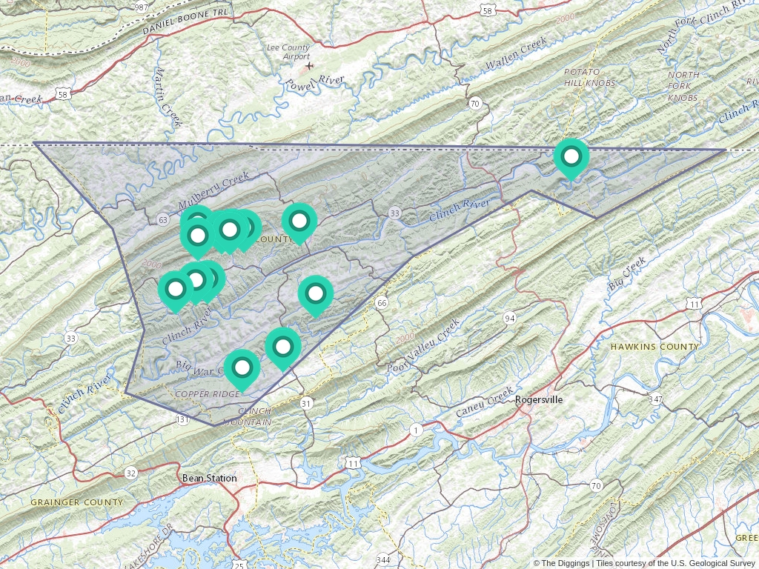
Notes:
14 mining operations sprang up across the county and when the zinc dried up, the mining companies bailed. It’s one of those situations where an area bases its economy largely on one commodity or industry and when that industry leaves, it pretty much wrecks the lives of the people left behind.
Now, the thing about zinc metal is that it’s never been found naturally all by itself. The vast majority of zinc deposits contain a mineral called…lead sulfide. And if your operation is only interested in and set-up for extracting zinc, the leftover lead is simply discarded. So you have all these abandoned mines along the main aquifer in Hancock, the Clinch River, with leftover lead out and open to the elements, and no subsequent effort to clean it all up. It’s no surprise that Hancock has the highest EBLL in the state.
So a big problem like this is beyond what a poor, rural community can solve themselves. A situation like falls under the purview of the EPA’s Superfund program.

Slide 24
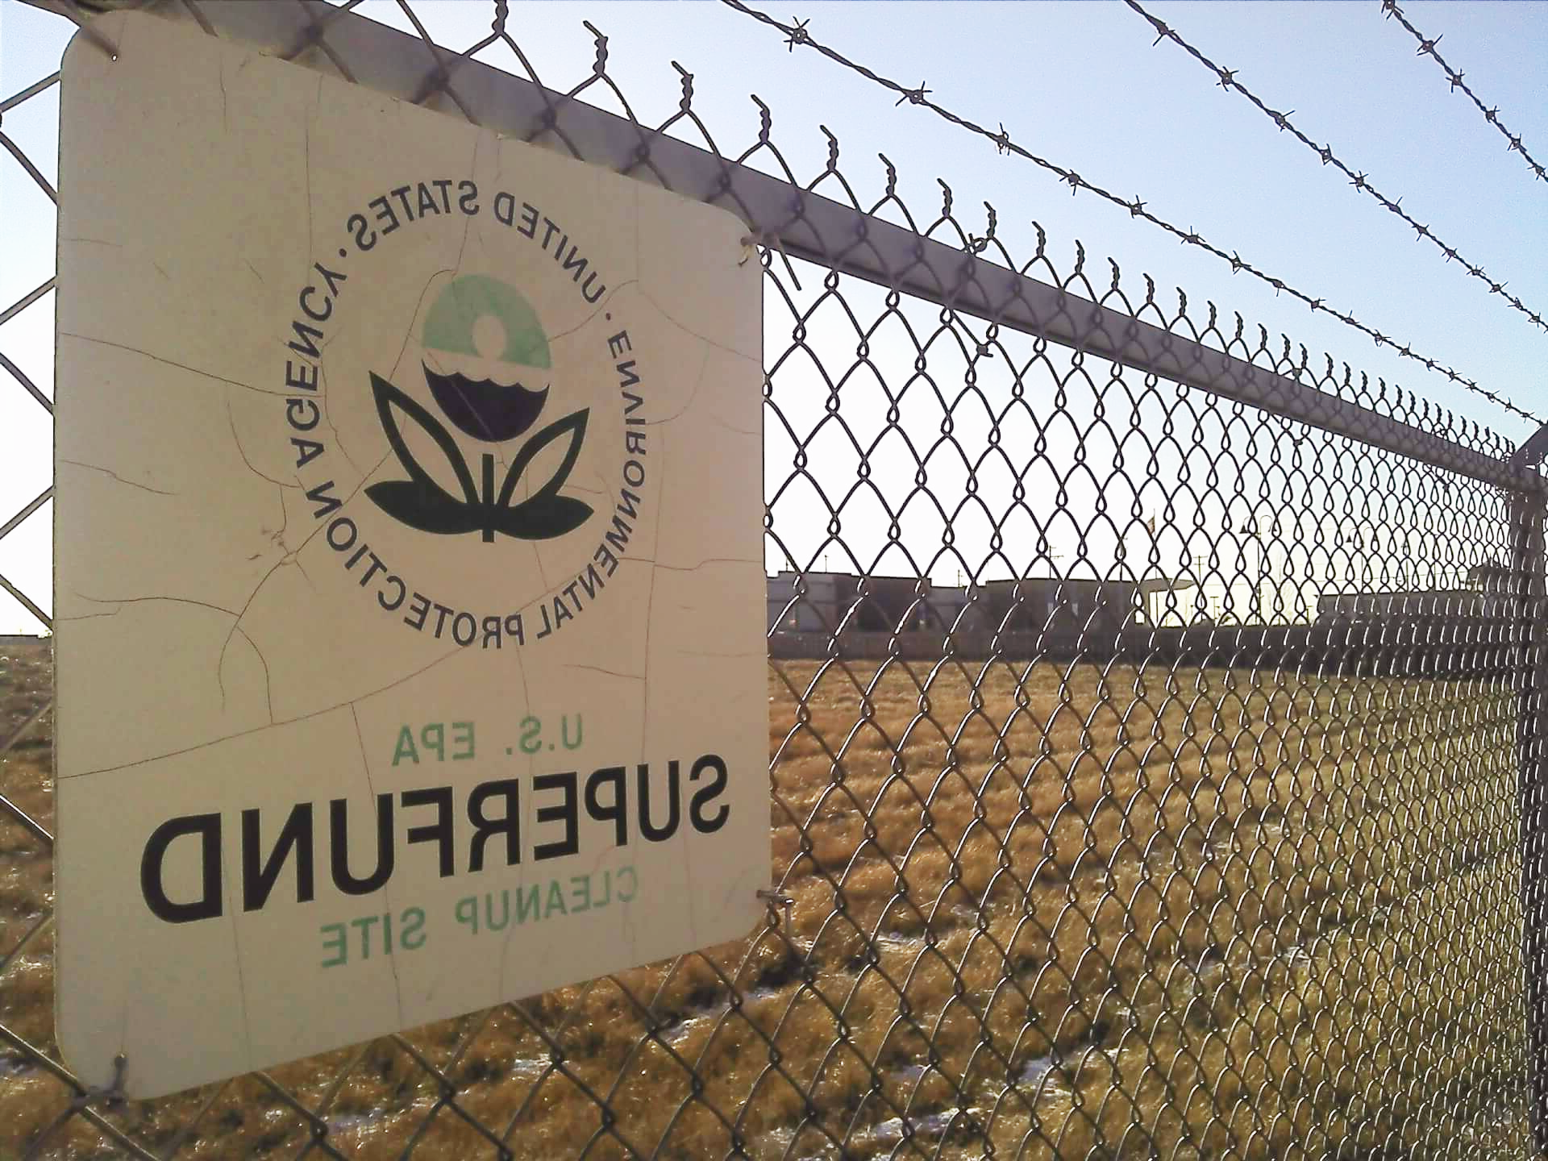

SUPERFUND SITES
The Superfund program grants the EPA the funds and authority to clean up contaminated sites when there’s no viable responsible party
Notes:
The Superfund program was started in 1980 to grant the EPA the funds and authority to clean up contaminated sites when there’s no viable responsible party. This could include abandoned factories, old industrial parks, processing plants, landfills, in addition to mining sites. And we have all of this and more here in Tennessee. Let’s take a look at the map.

Slide 25
Notes:
Here’s the EBLL map that we’re all familiar with by now.

Slide 26

Notes:
And here are all the currently active Superfund sites. It looks like Hancock County isn’t even on the EPA’s radar. We’ve still got some instances of high counties with Superfund sites over in west Tennessee, but from middle Tennessee and beyond you can clearly see the benefit of having an active environmental cleanup happening in your county.

Slide 27
13
Superfund Sites
32
Superfund Sites
Notes:
Of the 54 total Superfund sites in Tennessee, over half of them are in the low counties. So there’s clearly a huge disparity in the services being provided for the low group over the high group.
I actually live in an EPA Superfund site here in Southside Chattanooga. This area used to be home to a lot of metal foundries and as a result a lot of the soil in my neighborhood is contaminated with lead. Shortly after I moved in, I had the EPA come out and test my property to see if it’d be a candidate for remediation and I was just a few parts-per-million below the threshold. So, I try not to think about that when out and I’m enjoying my lawn.
Now, I’m sure there’s some grim math behind deciding where to establish a Superfund that certainly takes population and potential economic returns into account, but it’s kind of a self-fulfilling prophecy if that makes sense. If a particular county is doing badly overall and seeing their population in decline, which is the case for almost every county in the high group, and you use that as a reason not to invest as many resources into them, then they’re just going to keep getting worse.
The solution can’t be for poor people to just keep cranking out generations of kids until they’ve just absorbed all the toxins in their immediate environment into their bodies. And you can’t just wait it out because the half-life for lead is about 700 years. Obviously a well-funded and supported federal program that’s free at the point-of-service would be ideal, but that’s kind of a hard sell here in the age of austerity and neoliberalism. Some other states have some ideas though.

Slide 28
Lead Abatment Tax Credits
Ohio
Massachusetts
Rhode Island
$10,000 max credit per taxpayer
$1,500 per housing unit
$1,500 per housing unit for mitigation, $5,000 or abatement
Notes:
Here’s a few states that offer some kind of tax incentive for homeowners to work on lead contamination on their property. It’s not super great that we’re shifting the responsibility back onto individual citizens, but it is cool that they’ve made the credits available to owners of apartment buildings. So hopefully that results in renters also being protected. And these funds can be used not just for lead paint and lead pipes, it can also be used for the removal of lead contaminated soil. Which is probably the best you can do without EPA intervention.
And Ohio actually offers a grant for units in certain high-risk counties, so we love that. But of course, a tax credit isn’t an option for Tennessee because we don’t have an income tax!
But as great as removing lead paint and pipes is, if you’re not also targeting the soil and waterways then you’re leaving a huge access point for lead poisoning in your community. So if this is something you’re newly passionate about, then I highly recommend picking up some testing kits for your soil and tap water. Especially if you have kids in your home. You can get them on amazon or at the hardware store for about $30 a piece. And if you get a bad result, let your local departments of health and housing know. And if enough people do it, we might finally get the EPA’s attention.

Slide 29
Thank you!
Robert Parker//da09
Notes:
And that’s all I got! Thanks for listening and if anybody has any questions, I’m happy to try to answer them.

Slide 31

1970
1973
1996
1996
CDC sets acceptable blood-lead level of 40_{μg/dL}
EPA mandates a phaseout of leaded gasoline
Consumer Product Safety Commission bans lead paint
EPA eliminates lead from all U.S. motor fuel

